Slide 1





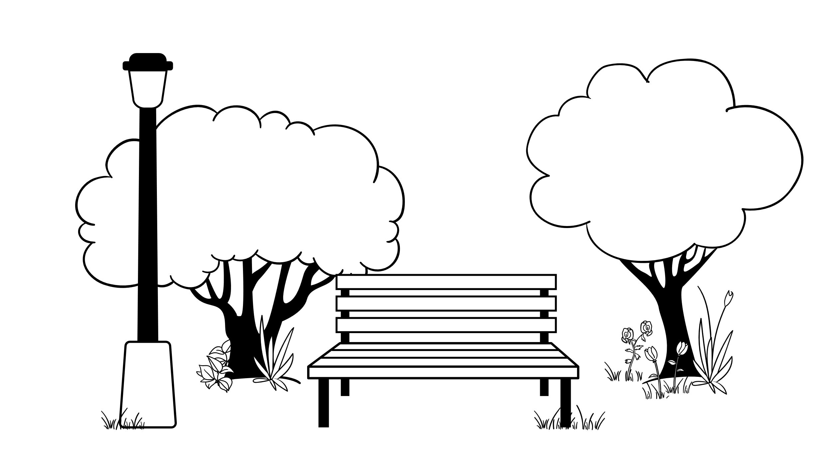



Milton Keynes Places Expansion Project (MKPEP)
Getting communities more active.
Hodge Lea
Kiln Farm Fullers Slade
Greenleys
Stacey Bushes
Beanhill
Coffee Hall
Eaglestone
Fishermead
Netherfield
Springfield
MKPEP Board is applying for funding from Sport England to help 11 MK estates get more active. Residents have been telling us what stops them getting active.
This is what they have said so far ….
Personal challenges:
Need more local clubs and activities:
No time to exercise
Health challenges
Not good enough
Safety concerns
Don’t know what is going on:
Need more local places to go:
Parks and playgrounds
Youth spaces
Going to activities difficult:
Buses unreliable
Activities cost too much
FOR MORE INFORMATION go to our web page here: [LINK HERE]
TO COMPLETE OUR SURVEY:
Adults and young people from 11 years click here: [LINK HERE]
Primary school children with parent/guardian permission click here: [LINK HERE]
Need more people to lead activities
Please tell us what you think by completing our short survey. This will help us prepare the strongest possible application for funding
for the MKPEP Board

